Slide 1
Factory Automation and Control Methods
Lecture 4: Introduction to Automation
Daro VAN
Paragon International University
Faculty of Engineering
Department of Industrial Engineering

Slide 2
Outline
Basic elements of an automated system
Advanced automation functions
Level of automation

Slide 3
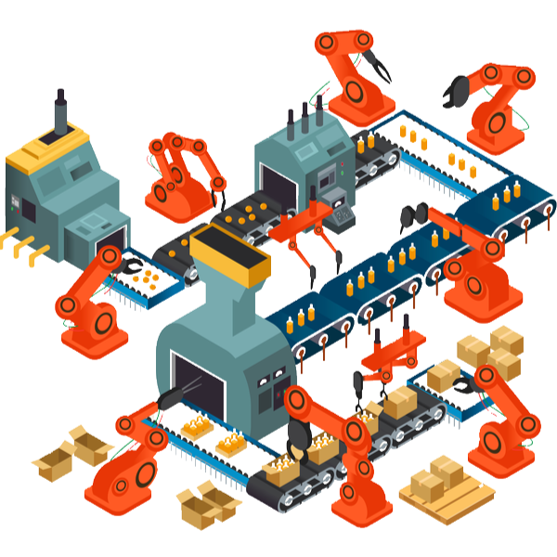
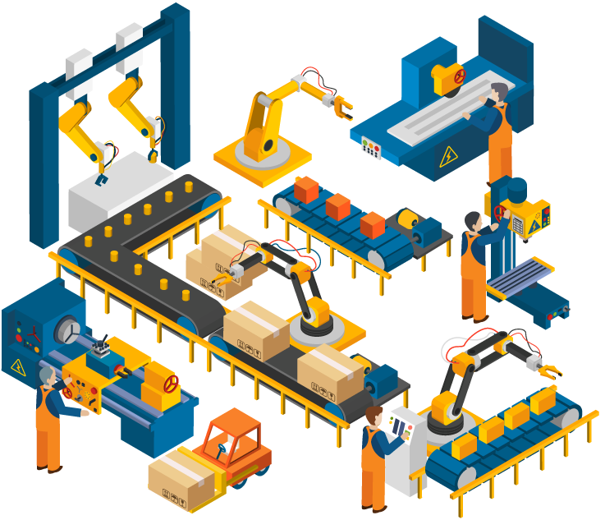
Overview

Slide 4
Overview
Automation can be defined as the technology by which a process or procedure is accomplished without human assistance.
It is implemented using a program of instructions combined with control systems that execute the instructions.
To automate a process, power is required, both to drive the process itself and to operate the program and control systems.

Slide 5
Learning Objective
After completing this class, you will be able to understand
the basic elements of an automated system from a high level perspective
some of the advanced features beyond basic elements and
the level of automation.

Slide 6
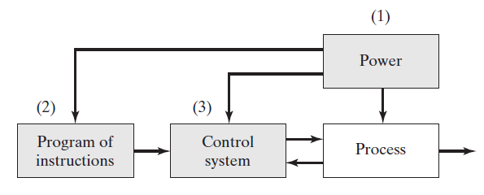
4.1 Basic Elements of Automated Systems
An automated system consists of three basic elements:
Power to accomplish the process and operate the system
Program of instructions to direct the process
Control system to actuate the instructions.

Slide 7
4.1 Basic Elements of Automated Systems 4.1.1 Power to Accomplish the Automated Process
The principal source of power in automated systems is electricity
Electric power is widely available at moderate cost
Electric power can be readily converted to alternative energy forms: mechanical, thermal, light, acoustic, hydraulic, and pneumatic.
Electric power at low levels can be used to accomplish functions such as signal transmission, information processing, and data storage and communication.
Electric energy can be stored in long-life batteries for use in locations where an external source of electrical power is not conveniently available.

Slide 8
4.1 Basic Elements of Automated Systems 4.1.1 Power to Accomplish the Automated Process
Power for the Process
Process | Power Form | Action Accomplished
Casting | Thermal | Melting the metal before pouring into a mold cavity where solidification occurs.
Electric discharge machining | Mechanical | Metal removal is accomplished by a series of discrete electrical discharges between electrode (tool) and workpiece. The electric discharges cause very high localized temperatures that melt the metal.
Forging | Mechanical | Metal work part is deformed by opposing dies. Work parts are often heated in advance of deformation, thus thermal power is also required.
Welding | Thermal , mechanical | Most welding processes use heat to cause fusion and coalescence of two (or more) metal parts at their contacting surfaces. Some welding processes also apply mechanical pressure.

Slide 9
4.1 Basic Elements of Automated Systems 4.1.1 Power to Accomplish the Automated Process
Power for the Process (cont.)
Process | Power Form | Action Accomplished
Heat-treating | Thermal | Metallic work unit is heated to temperature below melting point to effect microstructural changes.
Injection molding | Thermal and mechanical | Heat is used to raise temperature of polymer to highly plastic consistency, and mechanical force is used to inject the polymer melt into a mold cavity.
Laser beam cutting machining | Light, thermal and mechanical | A highly coherent light beam is used to cut material by vaporization and melting.
Sheet metal punching and blanking | Mechanical | Mechanical power is used to shear metal sheets and plates.

Slide 10
4.1 Basic Elements of Automated Systems 4.1.1 Power to Accomplish the Automated Process
Power for the Process
power is also required for the following material handling functions:
Loading and unloading the work unit
Material transport between operation

Slide 11
4.1 Basic Elements of Automated Systems 4.1.1 Power to Accomplish the Automated Process
Power for the Automation
power is also required for the following material handling functions:
Controller unit
Power to actuate the control signals
Data acquisition and information processing

Slide 12
4.1 Basic Elements of Automated Systems 4.1.2 Program of Instructions
Work cycle program
In the simplest automated processes, the work cycle consists of essentially one step, which is to maintain a single process parameter at a defined level.
Ex. Maintain the temperature of a furnace at a designed value for the duration of the heat treatment cycle
Note that here a process parameter is an input to the process, such as the temperature dial setting, whereas a process variable is the corresponding output of the process which is the actual temperature of the furnace.

Slide 13
4.1 Basic Elements of Automated Systems 4.1.2 Program of Instructions
Work cycle program
Set-point control : the process parameter value is constant during
the work cycle.
Logic control : the process parameter value depends on the values
of other variables in the process.
Sequence control : the value of the process parameter changes as a function of time. Ex. Load the part, then perform the process, and
then unload the part.
Interactive program : interaction occurs between a human operator
and the control system during the work cycle.
Intelligent program : the control system exhibits aspects of human intelligence (e.g., logic, decision making, cognition, learning) as a
result of the work cycle program.

Slide 14
4.1 Basic Elements of Automated Systems 4.1.2 Program of Instructions
Decision making in the programmed work cycle
Operator interaction: the controller unit may require input data
from a human operator in order to function.
Different part or product styles processed by the system: the automated system is programmed to perform different work
cycles on different part or product styles.
Variations in the starting work units : In some manufacturing operations, the starting work units are not consistent.

Slide 15

4.1 Basic Elements of Automated Systems 4.1.2 Control Systems
Control is everywhere in industrial applications, in nature and also in life
“No Control, No Life!”
And feedback is the key to success…

Slide 16

4.1 Basic Elements of Automated Systems 4.1.2 Control Systems
Control is an automated system that can be either closed loop or open loop.
Open-loop control systems

Slide 17
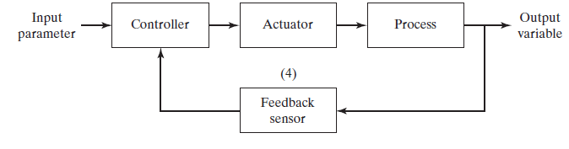
4.1 Basic Elements of Automated Systems 4.1.2 Control Systems
Control is an automated system that can be either closed loop or open loop.
Closed-loop control systems

Slide 18
4.2 Advanced Automation Functions
In addition to executing work cycle programs, an automated system may be capable of executing advanced functions that concerned with enhancing the safety and performance of the equipment.
Advanced automation functions include the following:
Safety monitoring
Maintenance and repair diagnostics
Error detection and recovery.

Slide 19
4.2 Advanced Automation Functions 4.2.1 Safety Monitoring
There are two reasons for providing an automated system with a safety monitoring capability:
To protect human workers in the vicinity of the system,
To protect the equipment comprising the system.

Slide 20
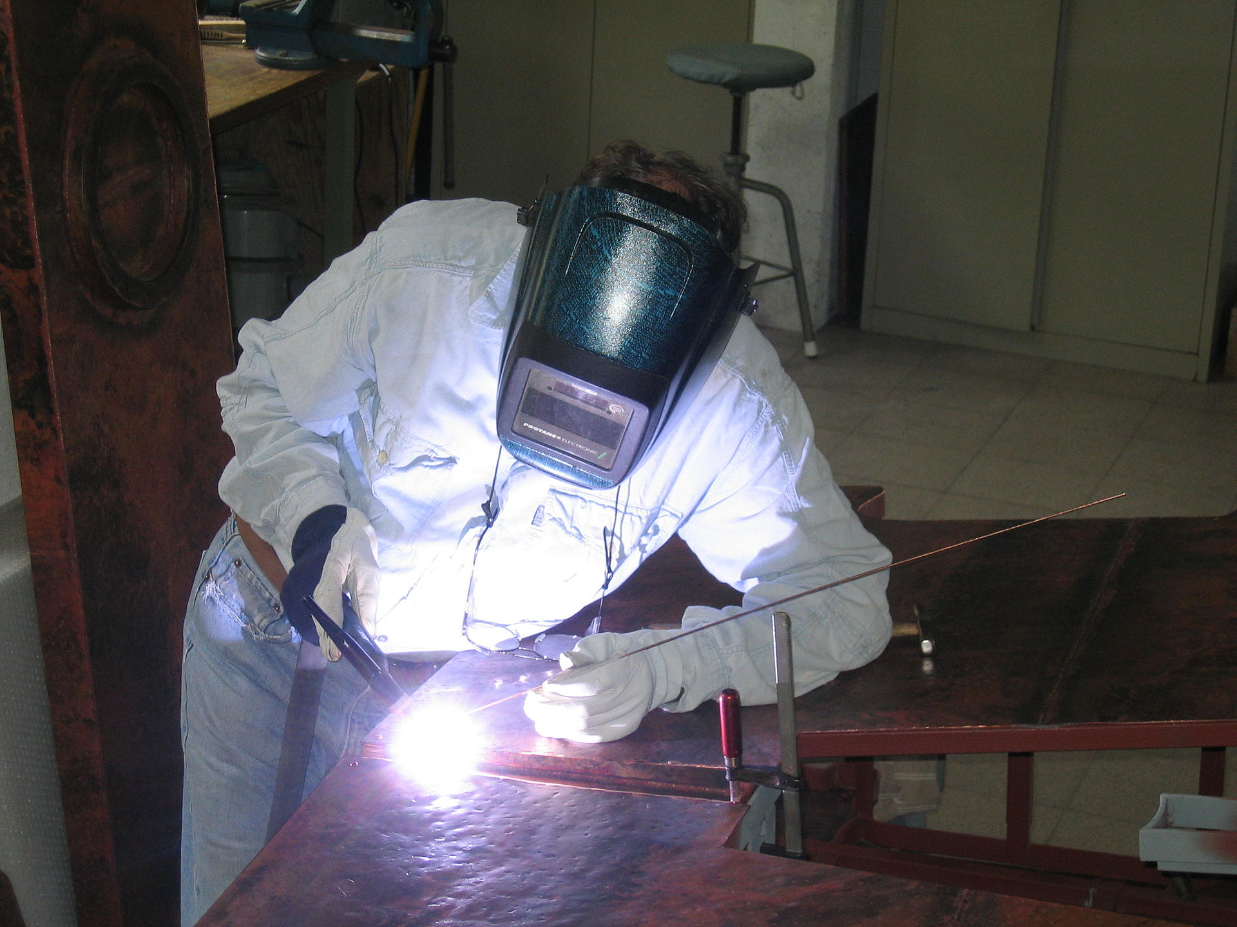


4.2 Advanced Automation Functions 4.2.1 Safety Monitoring
Conventional safety measures taken in manufacturing operation: protective shields, safety boot, glove …or the kinds of manual devices that might be utilized by workers

Slide 21
4.2 Advanced Automation Functions 4.2.1 Safety Monitoring
Safety monitoring in an automated system involves the use of sensors
To track the system’s operation
To identify conditions and events that are unsafe or potentially
unsafe.
The safety monitoring systems (commonly use sensor)is programmed to respond to unsafe conditions in some appropriate way. Possible responses to various hazards include one or more of
the following:
(1) Completely stopping the automated system,
(2) Sounding an alarm,
(3) Reducing the operating speed of the process, and
(4) Taking corrective actions to recover from the safety violation.

Slide 22
4.2 Advanced Automation Functions 4.2.1 Safety Monitoring
Some sensors for safety monitoring:
Limit switches
Photoelectric sensors
Temperature sensors
Heat or smoke detectors
Pressure-sensitive floor pads
Machine vision systems
…

Slide 23
4.2 Advanced Automation Functions 4.2.2 Maintenance and Repair Diagnostics
Three modes of operation are typical of a modern maintenance and repair
diagnostics subsystem:
Status monitoring : the diagnostic subsystem monitors and records the status of key sensors and parameters of the system during normal operation. It can be used
Provide information for diagnosing a current failure
Provide data to predict the future malfunction or failure.
…..

Slide 24
4.2 Advanced Automation Functions 4.2.2 Maintenance and Repair Diagnostics
2. Failure diagnostics : invoke when a malfunction or failure
occurs. Its purpose is to interpret the current values of the monitored variables and to analyze the recorded values preceding the failure so that its cause can be identified.
3. Recommendation of repair procedure: the subsystem recommends to the repair crew the steps that should be taken to effect repairs.

Slide 25
4.2 Advanced Automation Functions 4.2.2 Error Detection and Recovery
Error Detection
In analyzing a given production operation, the possible errors can be classified into one of three general categories:
Random errors: occurs due to the stochastic nature of the process
Systematic errors: results from some assignable cause such a change in raw materials or drift in an equipment setting
Aberrations: results from either an equipment failure or a human mistake.

Slide 26
4.2 Advanced Automation Functions 4.2.2 Error Detection and Recovery
Error Recovery
Generally, a specific recovery strategy and procedure must be designed for each different error. The types of strategies can be classified as follows:
Make adjustments at the end of the current work cycle.
2. Make adjustments during the current cycle.
3. Stop the process to invoke corrective action.
4. Stop the process and call for help.

Slide 27
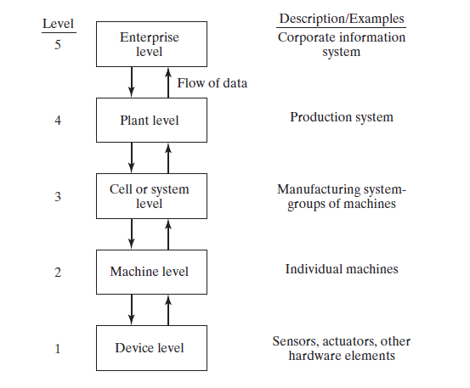
4.3 Levels of Automation

Slide 28
References
Mikell P. Groover, “Automation, Production Systems and Computer-integrated Manufacturing” , 4th edition, Pearson, chapter 2

